Slide 1


SWASTHYA
BECAUSE WE CARE
UTPAL MISHRA
October 14, 2022

Slide 2

Table of Content
Executive Summary
Deep dives
Problem Statement
Problem Solution
Uniqueness of the Solution
Business Model
Website Architecture
Impact and Scalability
Potential Roadblock
Glimpse of Developed Website
References

Slide 3
Executive Summary: Describe your idea in not more than 400 words; this should be like your 2–3-minute pitch to the investor
By this year's end, the Indian Healthcare Industry will reach a market evaluation of 372 billion dollars but still even the basic and paramount health virtuosos are kept hidden from a major portion of the population. A 2019 survey conducted in India revealed that more than 37 per cent of respondents suffered from at least one health condition, whereas almost 23 per cent reported one or more health conditions.
The first part of the approach is to Spread the Word with the intention is to extend the reach is Creating Awareness via Doctors, Media, Advertisement, Social Platforms, Celebrities, and Government - Organizing Free Health Camps/check-ups via Hospitals, Government and Private Organizations. Aware the locals of the symptoms, criticality and remedies for chronic diseases along with the measure to promote a healthy lifestyle.
The second part of the approach is via Building Web Application (Control Centre For Promoting and Creating Awareness on Health Issues):
Displaying details of all the health issues at the International and National levels with their Symptoms, Causes and Remedies (if, discovered).
The application will detect the location/ region and display a dashboard illustrating the details of fluctuating cases of diverse diseases in the locality, providing measures to be taken at different criticality levels of disease.
Option to book an Appointment with a Doctor and group the people with their disease and provide them with disease-curable meals and medications – as prescribed by the Routine Doctors, with advice for regular follow-up check-ups via monitoring the routine of the patients complemented by Free Health Camps.
Forwarding a proposal to collaborate at International, National and Sub-National levels to form a committee under WHO to closely monitor diseases from detection to finding a cure.

Slide 4
Deep dives: Please elaborate on the below in not mare than 400 words or 1-2 slides on each (Do provide any available demos, videos, POCs or existing research with your response)
Problem statement– What is the need? Why is the problem important to solve (current impact)?
Proposed solution: What is your approach? How developed is your idea? What technology or process is behind your solution?
Uniqueness of the idea: What is the novelty or differentiation of the idea? How is it different from pother existing or in pipeline solutions?
Business model: Who is your target audience? What is the proposed price point of your solution? How does it compare to others in the market? Any additional details on your proposed Go to market strategy?
Impact and scalability:
Do you have any existing evidence to establish confidence in the proposed idea that it will likely lead to change in status quo in the relevant area when at scale?
How easy will it be to adapt the solution specially with regards to meeting the growth and demand in the impacted area?
Potential roadblocks: What are the likely roadblocks this idea can face in terms of execution and implementation? Do you have any preliminary solution to address these roadblocks?
Team: Who is the team behind the idea?

Slide 5
PROBLEM STATEMENT
Address inadequacies in the system by pushing awareness and giving patients access to basic health and medical information
Stakeholder: Patient(Spread Knowledge) and Others (Spread Awareness)
2. Background: India has a chronic disease burden or non-communicable diseases burden of almost 20% of its population, where nearly 200 million people have some chronic disease. Of that, just diabetes and hypertension afflict some 100 million people, and that patient population is growing by 13% a year. To make matters worse, the rate of patient adherence to prescribed treatments is abysmally low

Slide 6
PROBLEM SOLUTION
What is your approach?
How developed is your idea?
What technology or process is behind your solution?
The approach is to unravel a web platform to decipher, analyze and create awareness with complete statistics of diseases in India (i.e. within States and Cities) – also globally - from its Spread, Active Areas, Affected Age-Groups with relevant Healthcare Centres - Hospitals and Clinic - for Booking Appointment and Treatment of a user in Close Proximity via Geo-location.
With present integration 5/7 components are completed – considering new upgrades with time for section website section. Presently, it incorporated sections are Home, About, Explore and Contact Page with a page illustrating timeline for Breast Cancer Stages.
Following are the tech stack that will be utilized for completing the website: Front-End: Python, Flask (Web Framework), HTML, CSS, JS.
Back-End: Python, SQL
Cloud Platforms: AWS/ Google Cloud.
Software Development Methodologies: Agile, Scrum, Crisp-DM.
MS Office Stack: Excel, Word, PowerPoint

Slide 7
UNIQUENESS OF THE SOLUTION
What is the novelty or differentiation of the idea?
How is it different from pother existing or in pipeline solutions?
The ideology is intend it to provide a healthcare platform so that people can not just be able to distinguish between symptoms and diseases but also book appointments with the clinics/ hospitals – with reference to the observed/ progressing influence on the health (even without any prior knowledge). Moreover, to create an awareness of chronic diseases (other diseases will be eventually incorporated) but also to develop a platform with active areas of disease enabled with enables with notification updates.
The uniqueness of the solution persist via approach to:
collect and display information/ details on manifolds of diseases.
self-exam the symptoms and book an appointment with a doctor.
use data encapsulated and display nearby health centres and medical shops in close-proximity.

Slide 8

BUSINESS MODEL
Usage-Based Model
Usage-Based Model
Usage-Based Model
Usage-Based Model
Usage-Based Model
Usage-Based Model

Slide 9
WEBSITE ARCHITECTURE
Outbreak Statistics
Active Areas
Search Nearby Clinics/ Hospitals with respect to Users Geolocation
Chronic Diseases
Stages Timeline
Symptoms and Solutions for Each Stage
Home
Details on Free Campaigns
About
Main Page
Explore
Dashboard
Display Cases of Chronic Diseases in diverse Regions
Predict Diseases with possibilities for an outbreak
Display weather, weather forecasting and AQI
Contact
Details on Upcoming Health Camps
Details on Upcoming Health Camps
Illustrate About Vaccination Drives

Slide 10
IMPACT AND SCALABITY
IMPACT
SCALABILITY
With an initiative to spread live and precise data with visual interpretations to the customers, the impact or the crowd will be on everyone.
Over 20 per cent of the country's population suffers from at least one of the non-communicable diseases (NCDs), which are estimated to cost India $ 6.2 trillion during the period 2012 – 2030.
According to the National Council on Aging, about 92 percent of seniors have at least one chronic disease and 77 percent have at least two. Heart disease, stroke, cancer, and diabetes are among the most common and costly chronic health conditions.
Since, with the website the people in focus will be everyone thus, before setting it live a suitable Cloud Platform and Cloud Servers will be considered for the support such as AWS, Azure or Google Cloud Services. Being dedicated for the public cloud will certainly be used so, AWS Services can be considered for providing a better support, relatively.

Slide 11
POTENTIAL ROADBLOCK
What are the likely roadblocks this idea can face in terms of execution and implementation?
Do you have any preliminary solution to address these roadblocks?
A few of the checkpoints with time would be to:
Gather precise data on at least most of the diseases in diverse regions.
Integrate exact locations of clinic, hospital and health camps.
Getting approval from Hospitals, Medical Clinics, Government in creating awareness and booking appointments when required with meal plans (will require support FDA) for suitable disease.
Bare the value of time, resources and permissions.
Since, the idea is to execute in iterations thus, for the initial iterations the focus can be directed towards the following:
Finding and scraping free data on diseases
Use social media to spread the word about the website benefits and influence in understanding and tacking diseases.
Connecting with local clinics to plugin-in their support in acknowledging people and encouraging to have check-up or test under ill conditions.
Focussing on a few Chronic Diseases such Breast Cancer, Covid-19, Diabetes and Hypertension.

Slide 12
MAIN PAGE

Slide 13


Slide 14
ABOUT PAGE

Slide 15
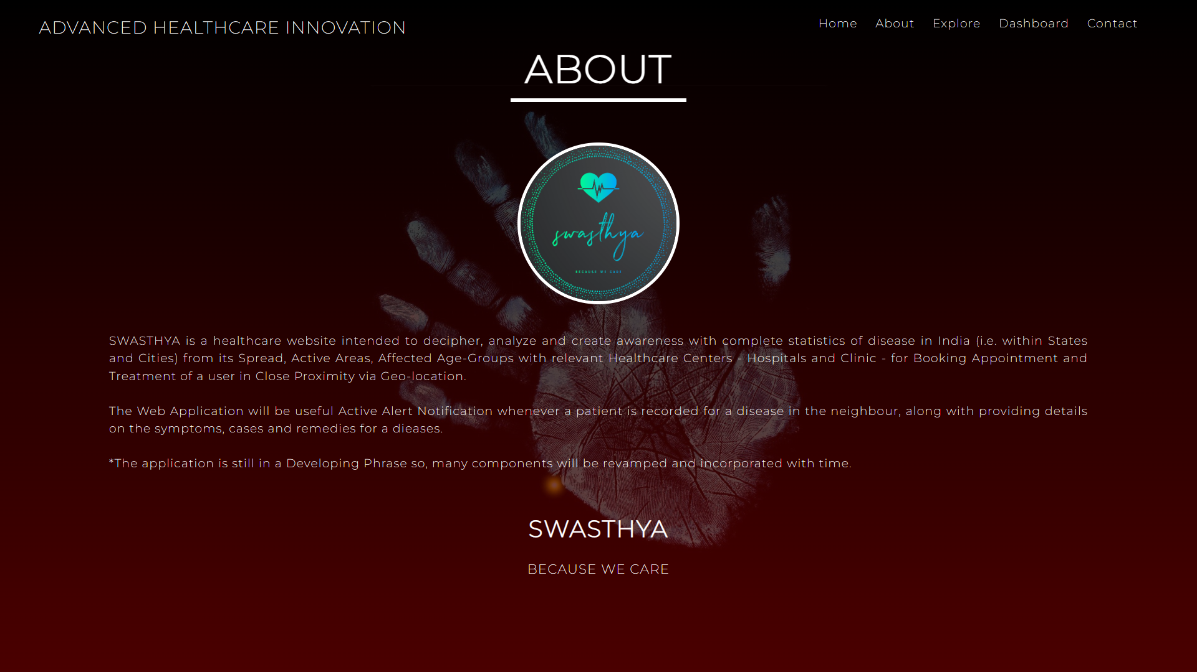

Slide 16
EXPLORE PAGE

Slide 17
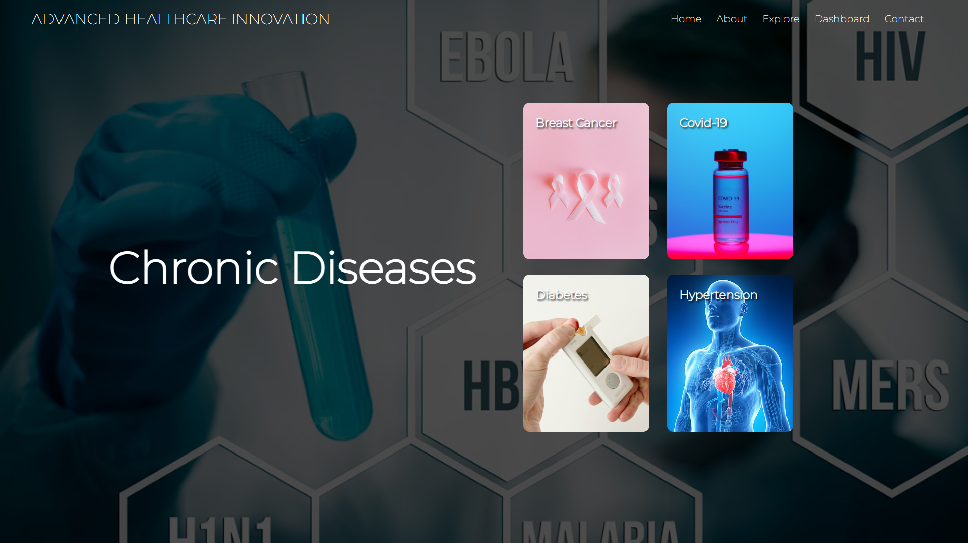

Slide 18
DISEASE TIMELINE

Slide 19
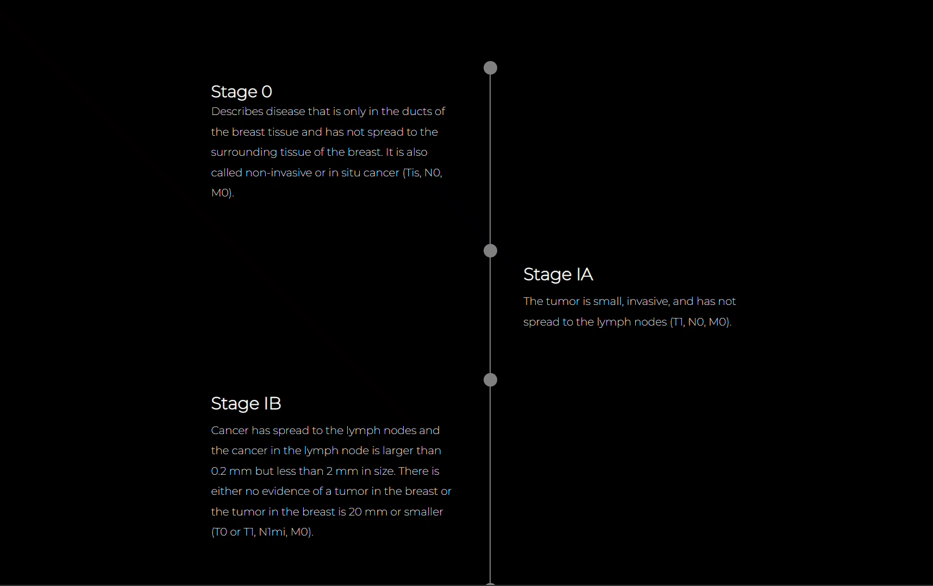

Slide 20
CONTACT

Slide 22
REFERNECES
https://bit.ly/3i8f4gT
https://bit.ly/3gtFARc
https://bit.ly/3tRWhca (Data)
https://www.youtube.com

Slide 23
UTPAL MISHRA
TEAM

